Slide 1

Department of Computer Science and Engineering Diabetic Retinopathy Detection Using Deep Learning and Explainable AI PRESENTED BY
Shaik Meera Jasmine (22471A05D0)
Pentyala Lakshmi Prasanna (22471A05B9)
Gorre Jayasri (22471A0591)
Under the Guidance of,
ABBURI RAMESH _{M.TECH}
Assistant Professor,
Department of Computer Science and Engineering,
Narasaraopeta Engineering College (Autonomous), Narasaraopet- 522 601.

Slide 2
OUTLINE:
Abstract
Introduction
Literature Survey
Research Gaps
Problem Statement
Objectives
Block Diagram / Flow Diagram
Methodology
Implementation
Results and Analysis
Conclusion & Future Scope
References
Acknowledgements
Question and Answers

Slide 3
Abstract:
Diabetic Retinopathy is a serious eye condition caused by prolonged diabetes and is one of the leading causes of blindness worldwide.
Early detection is challenging because initial stages do not show clear symptoms, making regular screening essential.
This project proposes an automated system using Convolutional Neural Networks (CNNs) to analyze retinal fundus images.
To improve trust and transparency, Explainable AI using LIME is integrated to visually explain model predictions.
The proposed system achieves high accuracy and can assist ophthalmologists in early diagnosis and treatment planning.

Slide 4
Introduction:
Diabetic Retinopathy occurs when high blood sugar damages the tiny blood vessels present in the retina, leading to vision problems.
In early stages, patients may not experience pain or vision loss, which delays diagnosis.
Traditional diagnosis involves manual examination by specialists, which is time-consuming and costly.
With the growth of artificial intelligence, automated systems can analyze medical images efficiently.
AI-based diagnosis helps in early detection, reduces workload on doctors, and improves patient care.

Slide 5
Problem Statement:
Manual screening of retinal images requires trained ophthalmologists and specialized equipment.
In rural and underdeveloped areas, access to eye specialists is limited, leading to delayed diagnosis.
Human diagnosis may vary due to fatigue, subjectivity, and experience level.
Existing automated systems often behave like black boxes without providing explanations.
Hence, there is a strong need for an accurate, automated, and explainable diagnostic system.

Slide 6
Motivation:
The number of diabetic patients is increasing rapidly across the world, increasing the risk of vision loss.
Early detection of Diabetic Retinopathy can prevent severe complications and blindness.
Deep learning has shown excellent performance in image-based disease detection.
Explainable AI helps doctors understand and trust AI predictions.
This project is motivated by the need to create a socially beneficial healthcare solution.

Slide 7
Objectives of the Project:
To design an automated system for detecting Diabetic Retinopathy from retinal fundus images.
To classify the disease into different severity levels accurately.
To develop a deep learning model with high accuracy and reliability.
To integrate Explainable AI techniques to interpret predictions.
To create a user-friendly web application for easy usage.

Slide 8
Scope of the Project:
The system can be used as a decision-support tool in hospitals and eye clinics.
It supports large-scale screening programs for diabetic patients.
The model can assist doctors but does not replace medical expertise.
The system can be extended to detect other retinal diseases.
It can be deployed in cloud or mobile healthcare platforms in the future.

Slide 9
Literature Survey:
Early research used traditional image processing and handcrafted features for detection.
Machine learning algorithms like SVM and Random Forest showed limited accuracy.
CNN-based deep learning models significantly improved performance.
However, most studies did not focus on explainability.
Recent research emphasizes the importance of Explainable AI in healthcare systems.

Slide 10
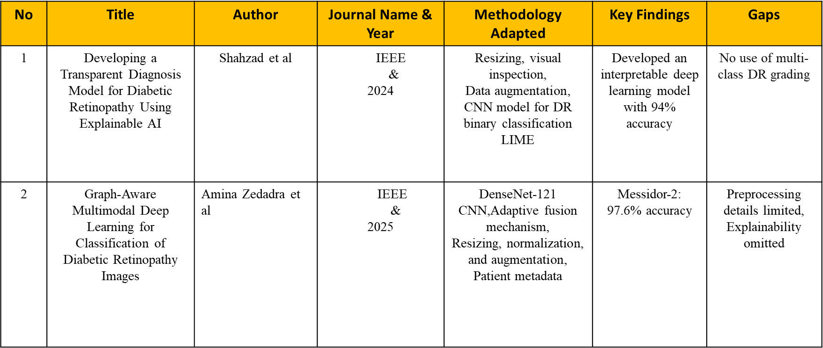

Slide 11
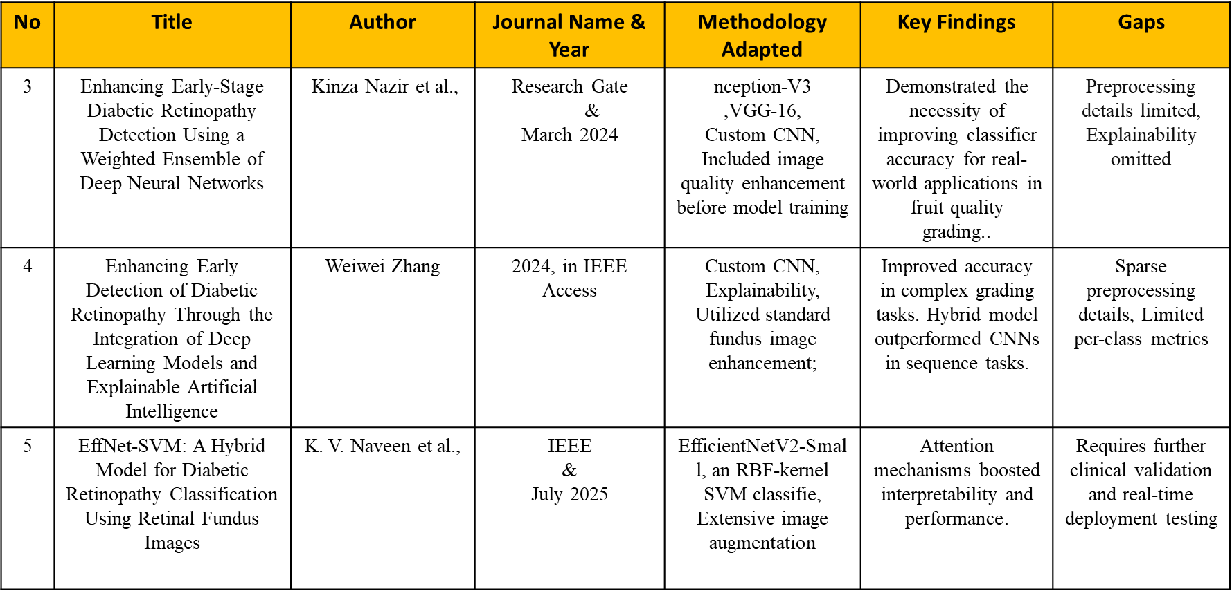

Slide 12
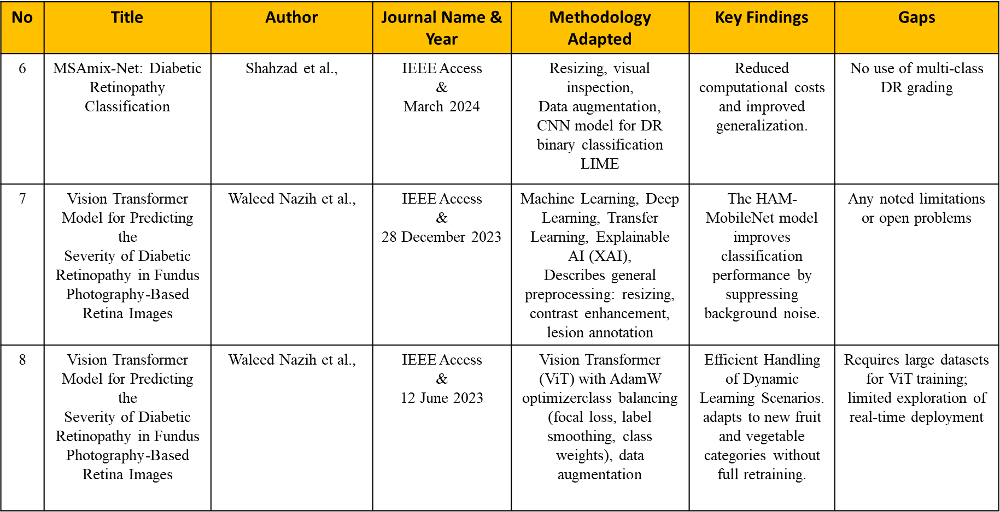

Slide 13
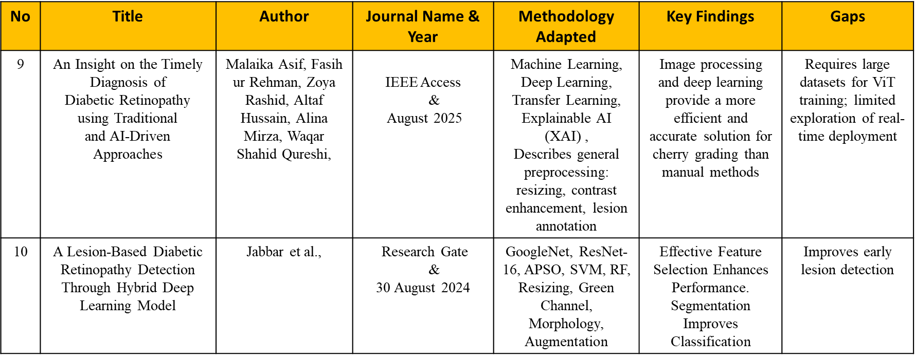

Slide 14
Research Gap:
Most existing models focus only on prediction accuracy.
Lack of transparency reduces trust among medical professionals.
Black-box nature of deep learning limits real-world adoption.
Overfitting and poor generalization are common issues.
There is a need for a system that balances accuracy and explainability.

Slide 15
Proposed System:
The proposed system uses a CNN-based deep learning model to classify retinal images.
Images are processed and passed through the trained model.
The model predicts the stage of Diabetic Retinopathy.
LIME is used to explain predictions visually.
A web interface allows users to upload images and view results easily.

Slide 16
Technology Stack:
Python is used as the primary programming language.
TensorFlow and Keras are used for building and training the CNN model.
OpenCV and NumPy are used for image preprocessing.
Flask is used to develop the backend server.
React is used to build a responsive frontend interface.

Slide 17
Dataset Description:
The dataset consists of retinal fundus images collected from publicly available medical datasets.
Images are labeled by medical professionals.
The dataset includes both healthy and diseased retinal images.
It represents different stages of Diabetic Retinopathy.
The dataset is suitable for supervised deep learning.

Slide 18
Dataset Classes:
The dataset used in this project is categorized into five distinct classes based on the severity of Diabetic Retinopathy, which helps in accurate medical diagnosis.
The No Diabetic Retinopathy class represents healthy retinal images without any visible damage.
The Mild and Moderate classes indicate early and intermediate stages where small abnormalities start appearing in retinal blood vessels.
The Severe and Proliferative classes represent advanced stages where abnormal blood vessel growth may cause serious vision loss.
This multi-class classification closely follows real clinical diagnosis standards.

Slide 19
Dataset Statistics:
The dataset contains a large number of retinal fundus images collected from reliable medical sources.
Images are properly divided into training, validation, and testing datasets to ensure unbiased evaluation.
The training set is used to teach the model patterns related to Diabetic Retinopathy.
The validation set helps tune the model and avoid overfitting.
The testing set is used only for final performance evaluation.

Slide 20
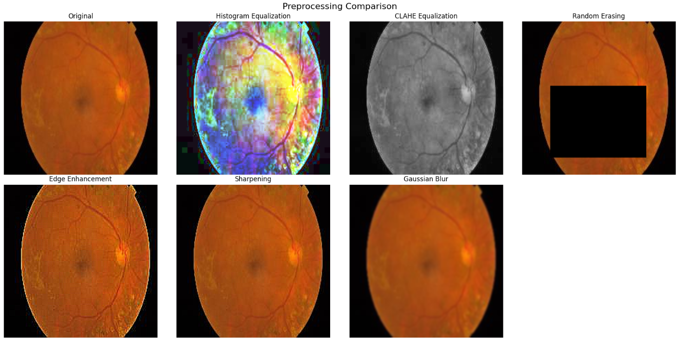
Data Preprocessing:
Preprocessing is performed to improve image quality and ensure compatibility with the deep learning model.
All images are resized to a fixed dimension so that they can be processed uniformly by the CNN.
Pixel normalization is applied to scale values between a fixed range, improving model convergence.
Noise removal and contrast enhancement help highlight important retinal features.
Proper preprocessing significantly improves classification accuracy.

Slide 21
Data Augmentation:
Data augmentation is used to artificially increase the size of the dataset without collecting new images.
Techniques such as rotation, horizontal flipping, zooming, and brightness adjustment are applied.
These transformations help the model learn invariant features.
Augmentation reduces overfitting and improves generalization to unseen data.
This is especially important in medical datasets with limited samples.

Slide 22
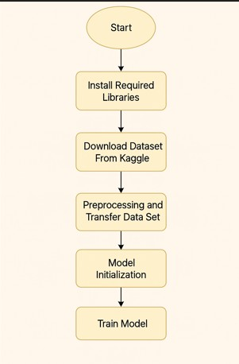
BLOCK DIAGRAM OR FLOW DIAGRAM:

Slide 23
Model Architecture Overview:
The proposed system uses a Convolutional Neural Network specifically designed for image classification.
Convolution layers extract spatial features like edges, textures, and patterns from retinal images.
Pooling layers reduce dimensionality and computational complexity.
Fully connected layers combine extracted features to make final predictions.
A Softmax layer outputs class probabilities for disease stages.

Slide 24
Convolutional Neural Network (CNN) Working:
The CNN processes input images through multiple convolution layers using learnable filters.
These filters capture important visual patterns related to Diabetic Retinopathy.
Pooling layers down sample feature maps to reduce noise and computation.
Fully connected layers analyze high-level features for classification.
This end-to-end learning approach enables accurate medical image analysis.

Slide 25
Model Training Process:
The model is trained using labeled retinal images in a supervised learning manner.
During training, a loss function calculates the difference between predicted and actual labels.
An optimizer updates model weights to minimize loss.
Training is performed over multiple epochs to improve learning.
Validation data is used to monitor performance and prevent overfitting.

Slide 26
System Flow Diagram:
The user uploads a retinal fundus image through the web interface.
The image undergoes preprocessing such as resizing and normalization.
The processed image is passed to the trained CNN model.
The model predicts the severity level of Diabetic Retinopathy.
LIME generates visual explanations for the prediction.
The final result is displayed to the user.

Slide 27
Backend Architecture:
The backend of the system is developed using Flask, a lightweight Python web framework.
The trained deep learning model is loaded on the server.
The backend handles image uploads securely.
It processes images and performs predictions efficiently.
Results are sent to the frontend using RESTful APIs.

Slide 28
Frontend Architecture:
The frontend is developed using React to create a responsive and user-friendly interface.
Users can upload retinal images easily using the web interface.
Prediction results and explanations are displayed clearly.
The frontend communicates with the backend using HTTP requests.
This separation improves scalability and maintainability.

Slide 29
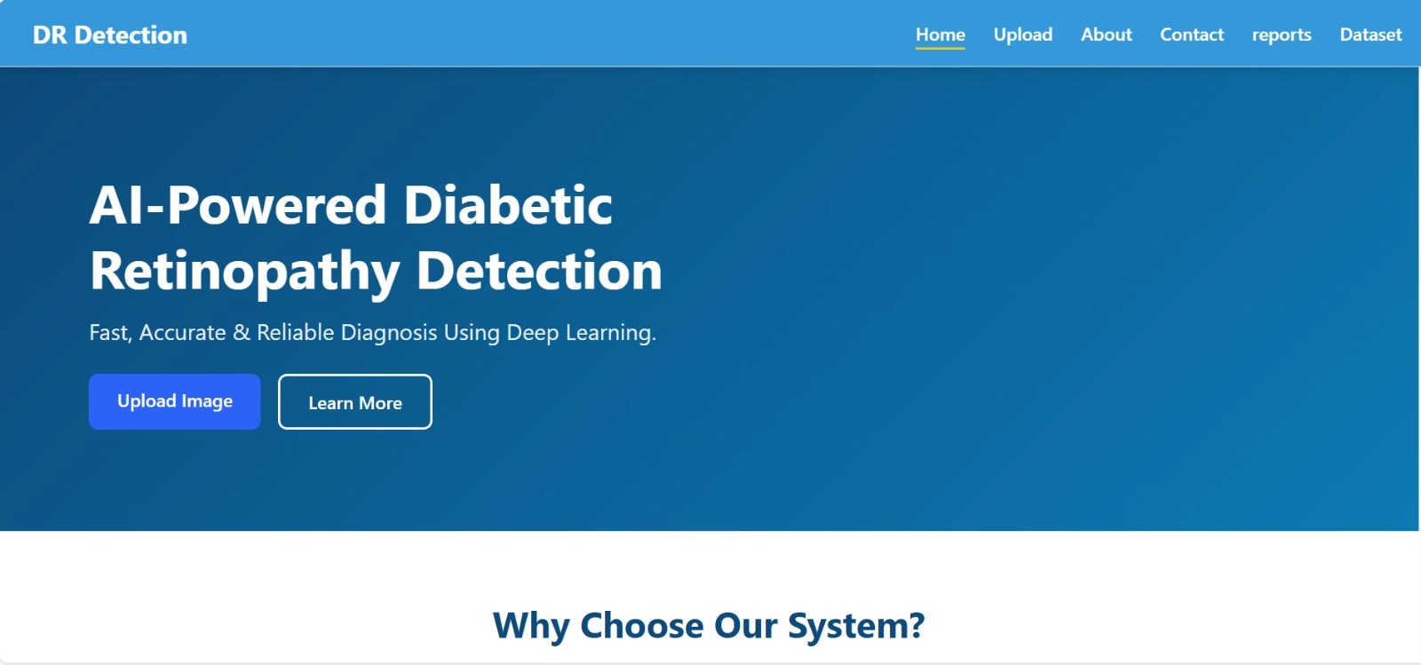
Home Page Interface:
The home page provides an overview of the Diabetic Retinopathy detection system.
It explains the purpose and importance of the application.
Navigation options guide users to different sections.
The interface is simple and easy to understand.
This page improves user engagement.

Slide 30
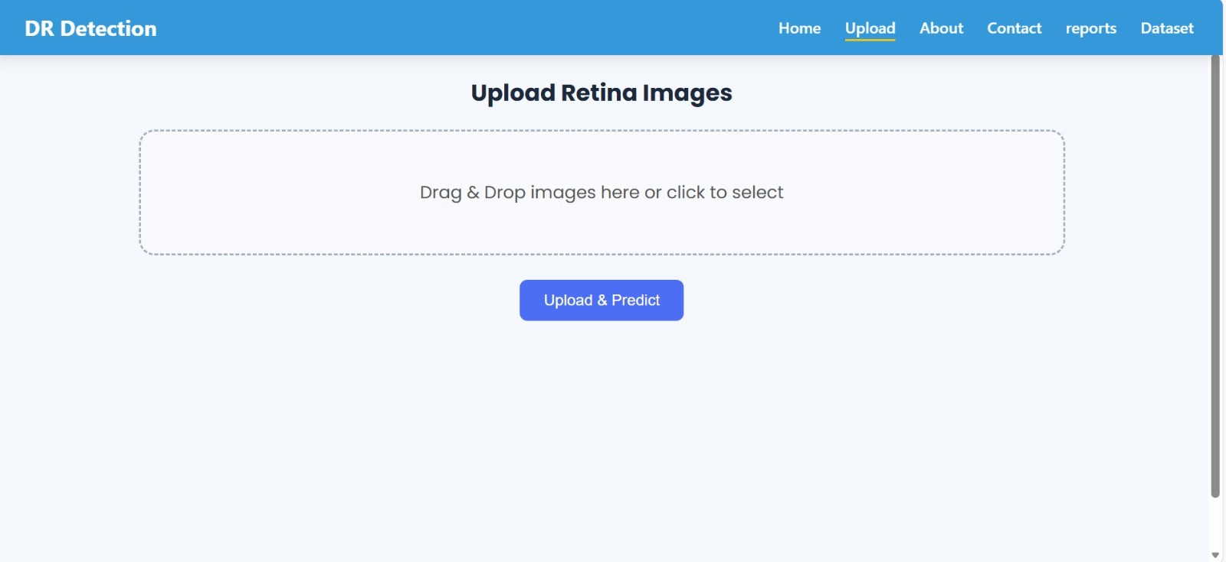
Image Upload Page:
This page allows users to upload retinal fundus images for analysis.
Supported image formats are displayed for user guidance.
The upload process is simple and fast.
Uploaded images are validated before processing.
This ensures smooth system operation.

Slide 31
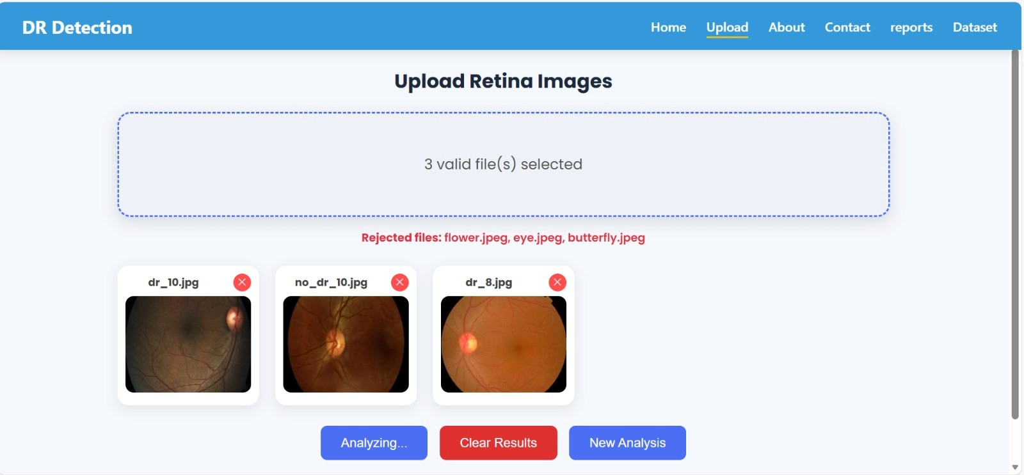
Prediction Results Page:
The prediction page displays the detected Diabetic Retinopathy stage.
Confidence scores indicate the reliability of predictions.
Clear results help doctors make informed decisions.
This page is crucial for diagnosis interpretation.
It enhances system usability.

Slide 32
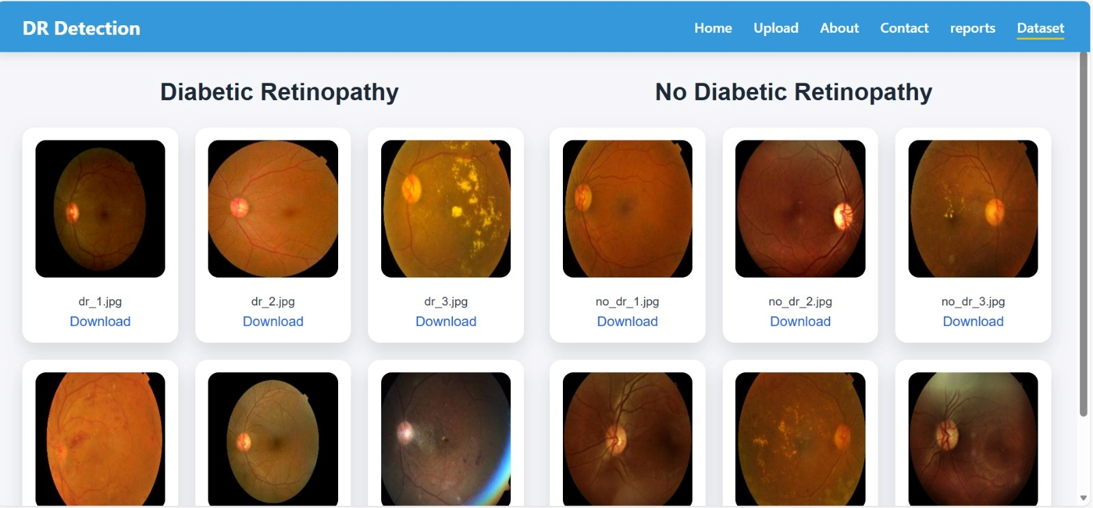
Dataset Visualization Page:
This page displays sample images from the dataset.
It helps users understand how images are categorized.
Shows different disease severity levels visually.
Improves transparency of data usage.
Useful for demonstration and learning.

Slide 33
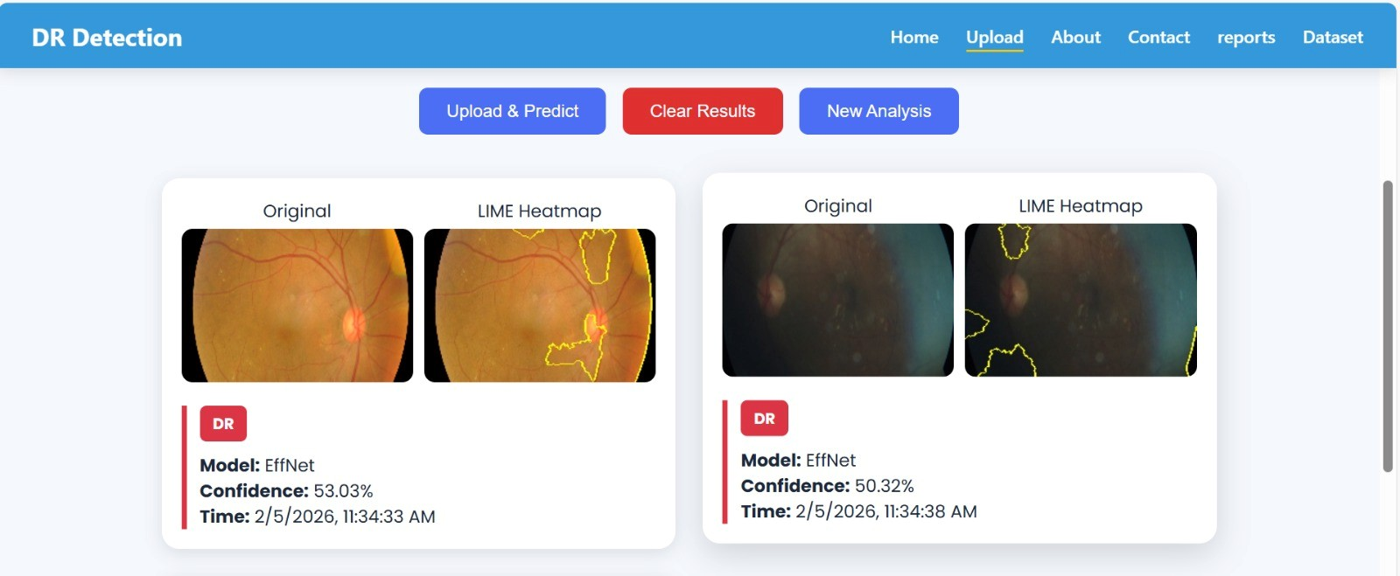
Explainable AI Output (LIME):
LIME highlights important retinal regions responsible for the prediction.
It visually explains why the model predicted a certain class.
This helps doctors trust the AI system.
It reduces the black-box nature of deep learning.
Essential for medical AI applications.

Slide 34
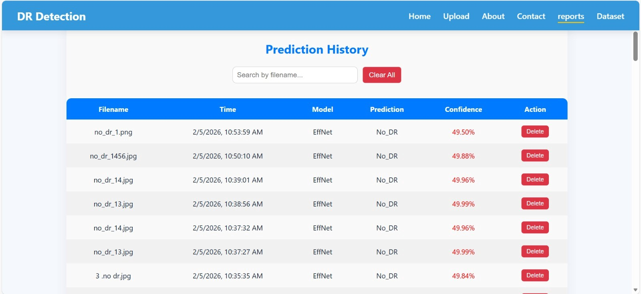
Result Report Page:
The report page summarizes the diagnosis details.
Displays predicted class, confidence score, and explanation.
Provides a clear and complete diagnosis overview.
Useful for documentation and review.
Improves clinical decision support.

Slide 35
Explainable Artificial Intelligence (XAI):
Explainable AI aims to make AI decisions understandable to humans.
It is essential in sensitive domains like healthcare.
Doctors need transparency before trusting AI predictions.
XAI improves ethical AI usage.
It bridges the gap between AI and medical experts.

Slide 36

LIME Overview:
LIME stands for Local Interpretable Model-Agnostic Explanations.
It explains individual predictions instead of the entire model.
LIME works with any machine learning model.
It provides visual explanations for images.
This improves model interpretability.

Slide 37
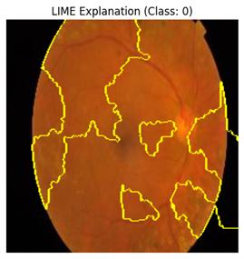
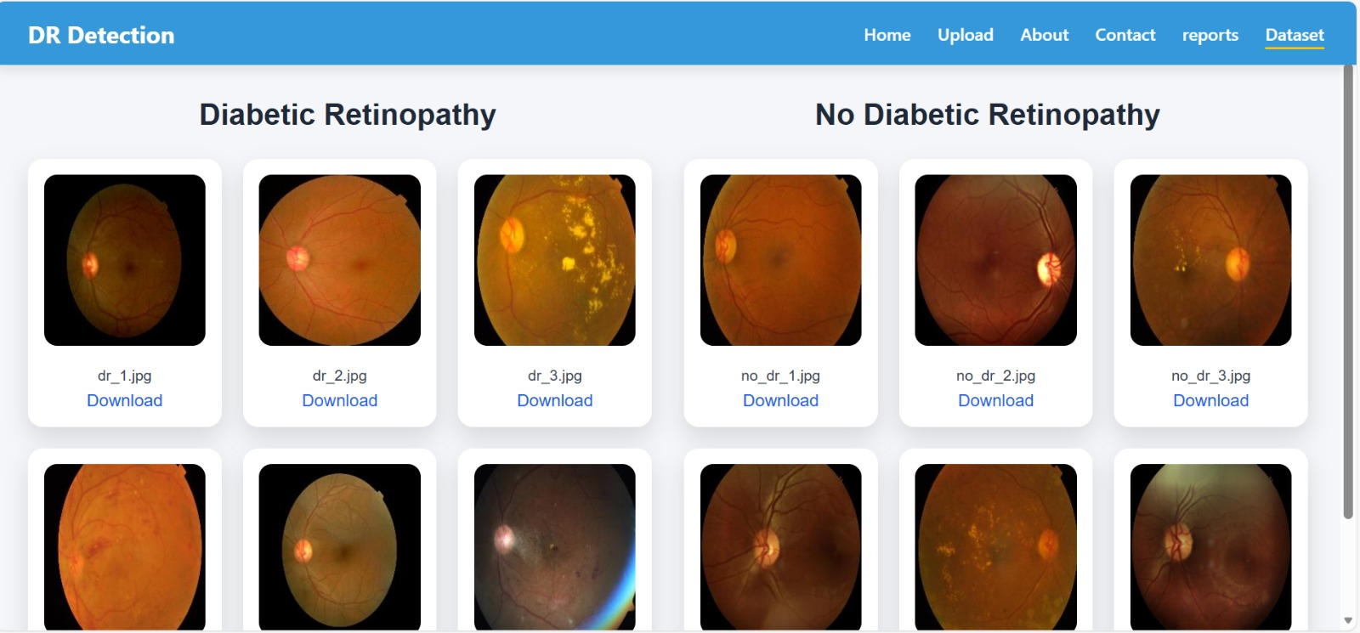
Working of LIME:
LIME perturbs the input image by modifying small regions.
It observes changes in the model’s output.
A local interpretable model is trained around the prediction.
Important image regions are identified.
Visual explanations are generated for users.

Slide 38
Performance Evaluation Metrics:
Accuracy measures overall correctness of predictions.
Precision measures how many predicted positives are correct.
Recall measures the ability to detect actual positives.
F1-score balances precision and recall.
These metrics are suitable for medical diagnosis evaluation.

Slide 39
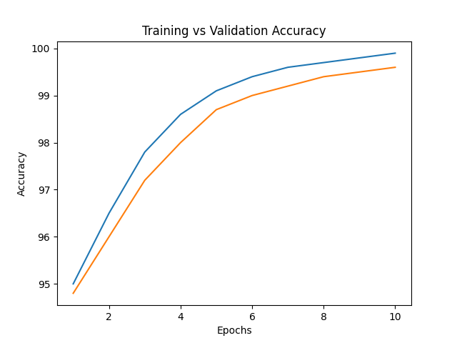
Training and Validation Accuracy:
The accuracy graph shows improvement over training epochs.
Training and validation accuracy follow similar trends.
This indicates good model generalization.
High accuracy confirms reliable learning.
Minimal overfitting is observed.

Slide 40
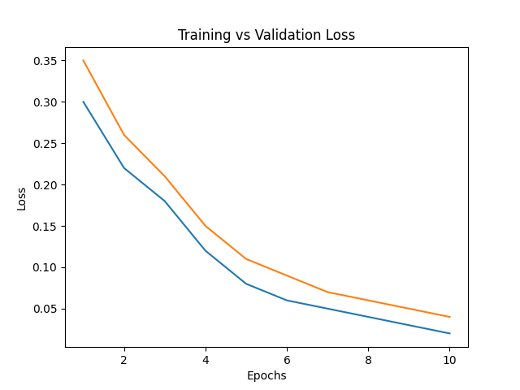
Training and Validation Loss:
The loss graph shows decreasing training loss.
Validation loss remains stable.
This indicates effective optimization.
Confirms that the model learned meaningful features.
Shows proper convergence.

Slide 41
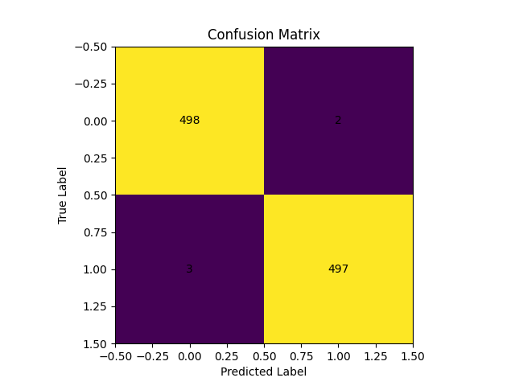
Confusion Matrix Analysis:
The confusion matrix shows class-wise prediction performance.
High diagonal values indicate correct predictions.
Low off-diagonal values show fewer misclassifications.
Helps analyze model weaknesses.
Confirms balanced classification.

Slide 42
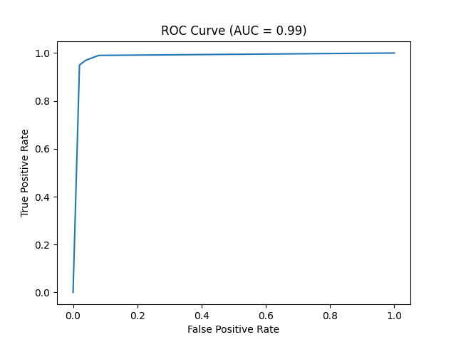
ROC Curve and AUC Score:
The ROC curve plots true positive rate vs false positive rate.
AUC score of 0.99 indicates excellent classification.
Shows strong separation between classes.
Confirms high diagnostic capability.
Suitable for medical applications.

Slide 43
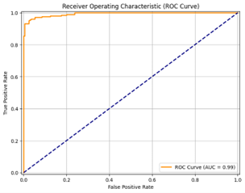
Experimental Results:
The model achieved an accuracy of 99.8%.
Precision, recall, and F1-score are also high.
Performance is consistent across classes.
The model is robust and reliable.
Suitable for real-world deployment.

Slide 44
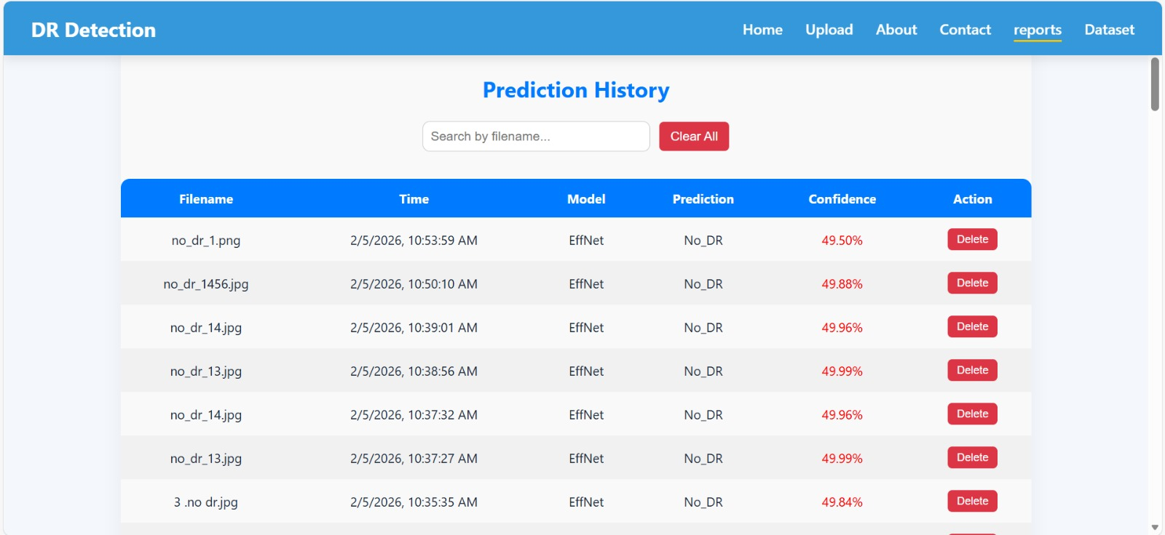
Results Summary:
The system successfully detects Diabetic Retinopathy.
Provides accurate and explainable predictions.
Reduces dependency on manual screening.
Improves early diagnosis.
Supports medical professionals.

Slide 45
Advantages of the Proposed System:
The proposed Diabetic Retinopathy detection system enables early identification of eye disease, which helps prevent permanent vision loss and blindness when treatment is started at the right time.
The system achieves very high accuracy by using deep learning techniques, making it more reliable than traditional manual screening methods.
The integration of Explainable AI (LIME) provides clear visual explanations, allowing doctors to understand why the model predicted a particular disease stage.
This system significantly reduces the workload of ophthalmologists by automating the initial screening process.
It provides consistent and unbiased results, avoiding human fatigue and subjective errors.
The web-based design allows easy access from any location, making it suitable for remote and rural healthcare environments.

Slide 46
Limitations of the System:
The system requires high-quality retinal fundus images; poor image quality can negatively affect prediction accuracy.
Performance of the model is dependent on the size and diversity of the training dataset, which may limit generalization to rare cases.
The system requires computational resources such as GPUs for training, which may not be available in all healthcare setups.
Internet connectivity is required to access the web-based application, which may be a limitation in remote areas.
The model currently focuses only on Diabetic Retinopathy and does not detect other eye diseases.
Clinical validation is still required before full-scale real-world deployment.

Slide 47
Future Enhancements:
A mobile application can be developed to allow doctors and patients to upload retinal images using smartphones.
The system can be enhanced to detect multiple eye diseases, such as glaucoma and cataracts.
Real-time diagnosis can be implemented using edge computing devices.
Cloud deployment can be added to support large-scale screening programs.
Continuous learning can be enabled by updating the model with new medical data.
Integration with hospital management systems will improve workflow efficiency.

Slide 48
Applications of the System:
The system can be used in hospitals and eye care centers for early screening of diabetic patients.
Diagnostic laboratories can use this system to speed up analysis and reduce manual effort.
Useful in rural healthcare camps where experienced ophthalmologists are not available.
Can be integrated into telemedicine platforms for remote diagnosis.
Government health programs can use this system for mass diabetic eye screening.
Medical research institutions can use it for further analysis and improvements.

Slide 49
Ethical Considerations:
Patient data privacy is a major concern, and all uploaded images must be handled securely.
Data encryption should be used during image transmission and storage.
The AI system should be used as a decision-support tool, not a replacement for doctors.
Bias in training data must be minimized to ensure fair predictions for all patients.
Proper consent must be obtained before using patient data.
Ethical AI deployment increases trust among healthcare professionals and patients.

Slide 50
Conclusion:
This project successfully demonstrates a deep learning-based system for Diabetic Retinopathy detection using retinal images.
The system achieves high accuracy and reliable performance, making it suitable for medical screening.
The use of Explainable AI (LIME) improves transparency and trust in AI predictions.
The web-based platform makes the system easy to use and accessible.
Early diagnosis through this system can significantly reduce the risk of blindness.
The project shows strong potential for real-world healthcare applications.

Slide 51
References:
IEEE research papers related to Diabetic Retinopathy detection using deep learning.
Kaggle EyePACS dataset for retinal fundus images.
TensorFlow and Keras official documentation for model development.
Research articles on Explainable AI and LIME methodology.
Medical journals related to diabetic eye disease diagnosis.

Slide 52
Thank You:
Thank you for giving us this opportunity to present our project.
We sincerely thank our guide and institution for their continuous support.
We welcome any questions or feedback regarding our project.

